Slide 1
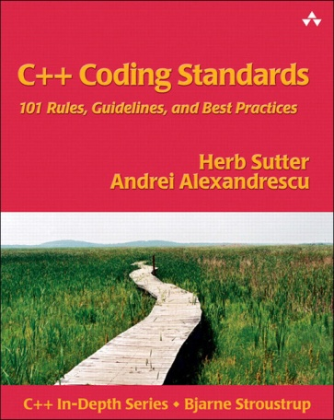

Coding Guidelines
CSD1451 – Project

Slide 2
Summmary
Why clean code matters
Unix Philosophy
DigiPen Guidelines
Few more tips

Slide 3
1.
Why clean code Matters

Slide 4
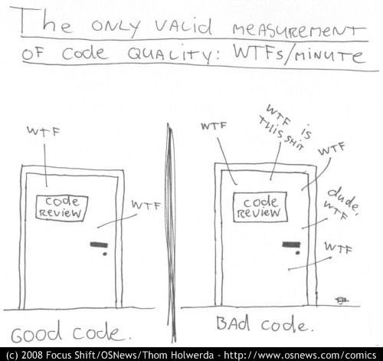

Slide 5
Professional Programmer Responsibilities
Write Code
That Runs
That Can be easily be Understood
That Can be easily Modified
Notes:
Code that runs, DUH
The other 2 are often forgotten, especially in smaller teams
When you get in Larger team, or longer project, time spent reading code vs Time spent coding

Slide 6
Why ?
Time spent reading code
>
Time spent Writing code
Notes:
The longer your project goes on, the more line of code you have in your code base, the more code you’ll read before doing something
The more people you have, the more time you will spend reading other ppl code

Slide 7
Programmer Activity
Source : Peter Hallam, C# Compiler Software Design Engineer at Microsoft

Slide 8
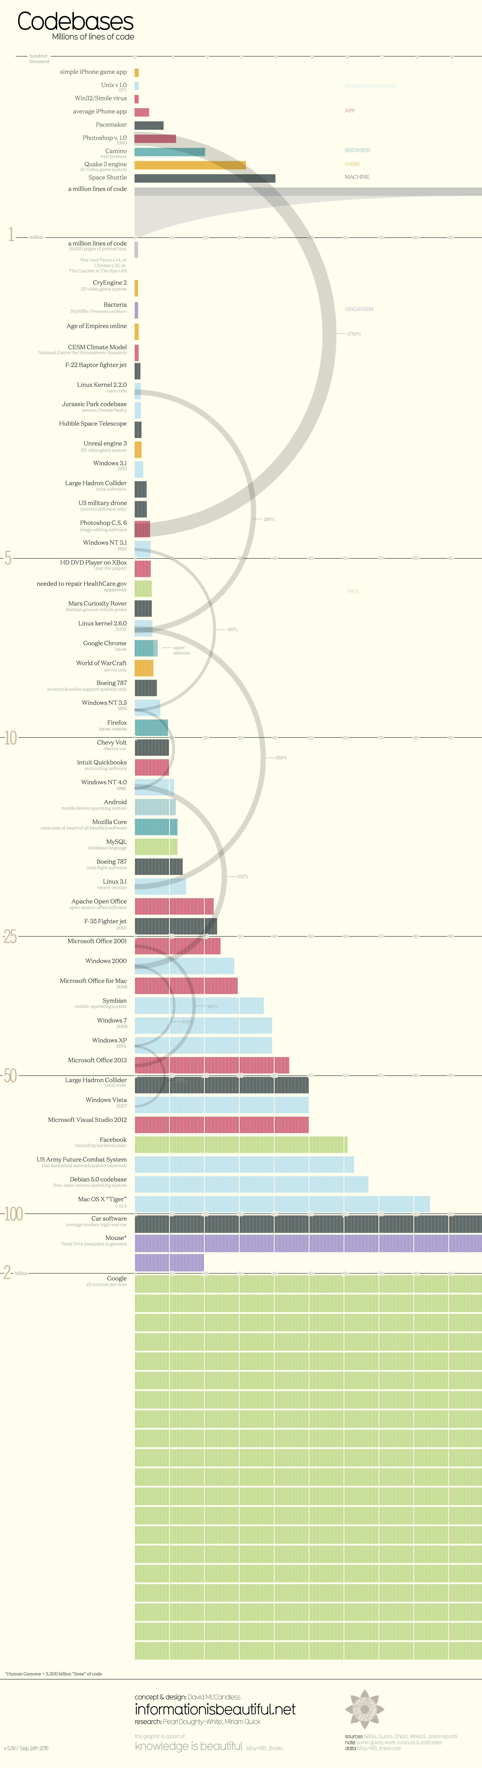

Slide 13
Code reading time Scales up
@ Google:
Big Code Base
2 Billion lines of code
Lots of Programmers
25000 Programmers
Notes:
Google = 40 times the size of windows OS
Google Progs have access to the full code base
Google is an Extreme case

Slide 14


Someone: “Hey, let’s remove the contextual crouch and let the player crouch when he wants”
Source: https://www.engadget.com/2014/10/06/the-crouch-that-changed-assassins-creed/?guccounter=1

Slide 15
“We rewrote like 6 million lines of code for this. It’s not a joke.
Our navigation seems very simple and very accessible, but to do this, it means that the system is calculating, before you’re actually moving, where the possibilities of where you’re actually going to go.”
-Alex Amancio
(Ubisoft)

Slide 16

We write good code, so it can be easily read
Reading badly formatted code, or with bad practices, makes us lose a lot of time.
Notes:
Not to be fancy, and it needs to be good to read not only for use later on, but also for other people
Reading badly formatted code, or with bad practices, makes us lose a lot of time.
Transmit to other people
A good coder is not someone that writes complex code, it someone that writes readable code

Slide 17
Code guidelines are actually used
Google C++ Coding Guidelines
https://google.github.io/styleguide/cppguide.html
ISO compiled by Bjarne Stroustrup
https://github.com/isocpp/CppCoreGuidelines
Notes:
(International Organization for standardization),

Slide 18
For DigiPen Students
Available in the Library

Slide 19
Best Practices
What is meant by “Best Practices”?
“A method or technique that has consistently shown results superior to those achieved with other means…”
-- Wikipedia.org
What is meant by “Best Coding Practices”?
“A set of informal rules that the software development community has learned over time to improve the quality of applications and simplify their maintenance.”
-- Wikipedia.org
Notes:
Copy and pasting code, hardcoding. Does it improve quality? Does it simplify maintenance?

Slide 20
Best Practices = principles to produce better code
- Easier to understand
- With less bugs
Notes:
Not to be fancy, and it needs to be good to read not only for use later on, but also for other people
Reading badly formatted code, or with bad practices, makes us lose a lot of time.
Transmit to other people

Slide 21
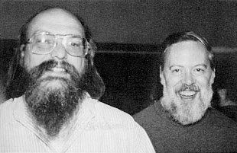
Unix Philosophy
Ken Thompson and Dennis Ritchie
Design rules for modular software development
https://en.wikipedia.org/wiki/Unix_philosophy
Notes:
Old principles, still relevant today, even more so with the web dev protocols

Slide 22
The rules
Rule of Modularity: Write simple parts connected by clean interfaces.
Rule of Clarity: Clarity is better than cleverness.
Rule of Composition: Design programs to be connected to other programs.
Rule of Separation: Separate policy from mechanism; separate interfaces from engines.
Rule of Simplicity: Design for simplicity; add complexity only where you must.
Rule of Parsimony: Write a big program only when it is clear by demonstration that nothing else will do.
Rule of Transparency: Design for visibility to make inspection and debugging easier.
Rule of Robustness: Robustness is the child of transparency and simplicity.
Rule of Representation: Fold knowledge into data so program logic can be stupid and robust.
Rule of Least Surprise: In interface design, always do the least surprising thing.
Rule of Silence: When a program has nothing surprising to say, it should say nothing.
Rule of Repair: When you must fail, fail noisily and as soon as possible.
Rule of Economy: Programmer time is expensive; conserve it in preference to machine time.
Rule of Generation: Avoid hand-hacking; write programs to write programs when you can.
Rule of Optimization: Prototype before polishing. Get it working before you optimize it.
Rule of Diversity: Distrust all claims for “one true way”.
Rule of Extensibility: Design for the future, because it will be here sooner than you think.
Notes:
Only going through some in depth, but should consider the rest too.

Slide 23
TLDR
Value simplicity and maintainability over performance and complexity
Notes:
A good coder is not someone that writes complex code, it someone that writes readable code

Slide 24

Notes:
Or

Slide 25
Rule of Clarity
2
Clarity is better than cleverness.
Notes:
Because maintenance is so important and so expensive, write programs as if the most important communication they do is not to the computer that executes them but to the human beings who will read and maintain the source code in the future (including yourself).

Slide 26

Example: ???
float Q_rsqrt(float number)
{
long i;
float x2, y;
const float threehalfs = 1.5F;
x2 = number * 0.5F;
y = number;
i = *(long *)&y; // evil floating point bit level hacking
i = 0x5f3759df - (i >> 1); // whatttt?
y = *(float *)&i;
y = y * (threehalfs - (x2 * y * y)); // 1st iteration
// 2nd iteration, this can be removed
//y = y * ( threehalfs - ( x2 * y * y ) );
return y;
}
?????

Slide 27
Example: Quake 3 Arena
float Q_rsqrt(float number)
{
long i;
float x2, y;
const float threehalfs = 1.5F;
x2 = number * 0.5F;
y = number;
i = *(long *)&y; // evil floating point bit level hacking
i = 0x5f3759df - (i >> 1); // whatttt?
y = *(float *)&i;
y = y * (threehalfs - (x2 * y * y)); // 1st iteration
// 2nd iteration, this can be removed
//y = y * ( threehalfs - ( x2 * y * y ) );
return y;
}
Notes:
Fast inverse square root
Used to Normalize Vectors
Generally not applicable With subsequent hardware advancements, especially the x86 SSE instruction

Slide 28
Example: Quake 3 Arena
Fast inverse square root
Used to Normalize Vectors
hardware advancements, (especially the x86 SSE instruction) made it generally obsolete

Slide 29
Rule of Clarity
Comment your code properly
Do not use “Magic Formulas”
They might not work as you think, with marginal benefits
Think about your coworker, how they will use and maintain your code

Slide 30
Rule of Simplicity
5
Design for simplicity.
Add complexity only where you must
Notes:
Because maintenance is so important and so expensive, write programs as if the most important communication they do is not to the computer that executes them but to the human beings who will read and maintain the source code in the future (including yourself).

Slide 31
Rule of simplicity
Develop what you need now
Avoid Feature creep
More features
== more complexity
== more bugs
== more code to maintain
== more code to test
Notes:
Not what you think you might need someday and might NEVER be used
Best way to end up with features that no one will ever use.
More complexity = more expensive and buggy)

Slide 32
Rule of Transparency
7
Design for visibility to make inspection and debugging easier.

Slide 33
Rule of Transparency
Understand what a class does by reading the Declaration
Understand the execution while you debug
Requires :
Proper naming
Proper comments
Proper access ( private, protected, public )
Proper Function breakdown
Notes:
a

Slide 34
Rule of Representation
9
Fold knowledge into data so program logic can be stupid and robust.

Slide 35
Rule of Representation
Humans are better at visualizing data than reading code flow
Move complex information into structures
Process structures with algorithm
Avoid long winded functions with parameters
Notes:
Most software is fragile and buggy because most programs are too complicated for a human brain to understand all at once.

Slide 36
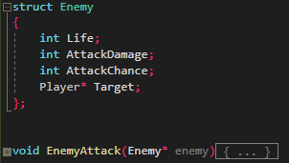
If the Attack logic change, Update ALL the function calls
VS
Can change all the AI locally, without touching the main calls

Slide 37
Rule of Repair
11
When you must fail, fail noisily and as soon as possible.

Slide 38
Rule of Repair
Avoid Defensive programming
“Ensure the continuing function of a piece of Software under unforeseen circumstances”
Code becomes increasingly complex
Use Assert !
Crash during development, fix the flow issues

Slide 39
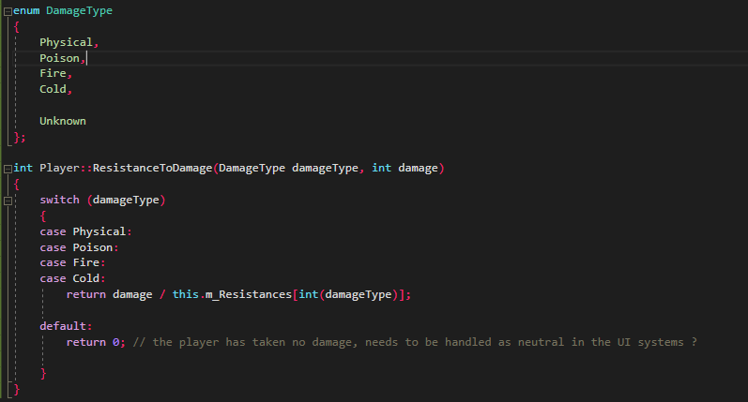
You have to handle the return of 0 everywhere

Slide 40
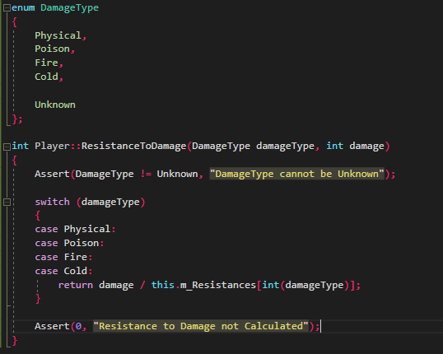
It will Crash in case of wrong DamageType...
Fix the wrong calls, not the consequences of a wrong call

Slide 41
Rule of Optimization
15
Prototype before polishing. Get it working before you optimize it.

Slide 42
Rule of Optimization
Make your code work first, optimize later
Measure Performance. Don’t optimize until you've measured
Notes:
Compilers are extremely smart now, You don t know how the compiler will automatically improve your code;

Slide 43
3.
DigiPen Guidelines

Slide 44
Don’t sweat the small stuff.
0

Slide 45
Don’t sweat the small stuff
Know what not to standardize.
Don’t enforce personal tastes or obsolete practices.
“Don’t over legislate naming, but do use a consistent naming convention.”
“Don’t prescribe commenting styles, but do write useful comments.”
Notes:
KISS = keep your rules simple
Don’t have to create a whole new C++ grammar end enforce it, Keep it fun and manageable
Example is the Hungarian notation

Slide 46
Compile cleanly at high warning levels
1

Slide 47
Compile cleanly at high warning levels.
“Your compiler is your friend.”
Warnings are potential problems in your code.
Ignoring warnings will allow serious bugs to creep into your code.
Consider enabling “Treat warnings as errors” option in VS
Notes:
Changing warning Level is a big NO NO
If you have not done so, do it now. (Just like fixing your memory leaks)

Slide 48
Invest in Code reviews
4
Notes:
IT’s not your producer that will do that, the producer COORDINATES effort to produce it
Everyone needs to agree on estimations

Slide 49
Invest in code reviews
“More eyes will help make more quality. Show your code and read others’. You’ll all learn and benefit.”
When done right, the benefits far outweigh the costs
Teach / Learn about code blocks
Enforce proper usage of systems
Notes:
Explain what it is. Explain that you can do it remotely
Often avoided because it “cost too much time”
Time saved vs. cost of code review alone
Factor in all the other benefits
Teach / Learn about code blocks => what if there is a bug in the code of a person that is not available that day ?

Slide 50
Give one entity one cohesive responsibility
5

Slide 51
Give one entity one cohesive responsibility.
Entities can be files, classes, structs, variables…
The smaller your entity, the easier to use.
One responsibility = easier refinement, update and readiness.
Notes:
Entity with multiple responsibility will grow exponentially complex as each responsibility grows: you will have to manage the responsibilities of each class

Slide 52
Give one entity one cohesive responsibility.
Consider simple and short functions.
How difficult is it to maintain a module (.cpp/.h)?
The bigger your files the worst in:
Maintenance.
Compilation time.
Splitting.
Reading and navigation.

Slide 53
Correctness, simplicity and clarity
6

Slide 54
Correctness, simplicity, and clarity come first
Improve readability and maintainability
Often Clarity > Optimization
Modern compilers perform many optimizations to your code
https://en.wikipedia.org/wiki/Optimizing_compiler
Optimize after measuring performance
Notes:
Think about the examples I gave earlier

Slide 55
Minimize Global & Shared data
10

Slide 56
Minimize Global & Shared data
Decrease coupling (interdependency)
Example: animations
Should the screen display code know the internals of the animation code?
Should the animation code know the internals of the screen display code?
Define functions that allow the two systems to operate together.

Slide 57
Hide Information
10

Slide 58
Hide information
Don’t give up control of your information.
Provide an abstract interface that controls access to information.
Prevents control of data within module
Potentially improves flexibility

Slide 59
Example: health
“health” is defined as public
(or extern’ed in header)
Anyone can, and probably will, write:
What can happen ?
What if health is already zero?
What if health becomes negative?
enemy->health -= weapon->damage;

Slide 60
Example: health
Provide an abstract interface to your data, e.g.:
These abstract functions can
Prevent out-of-range values
Perform error checking
Trigger events, if necessary
// Set an NPC’s health to a specific value.
void NpcSetHealth(int health)
{ ... }
// Modify an NPC’s health up/down by a specific amount.
void NpcModifyHealth(int health)
{ ... }
Notes:
Or Getter / Setters in advanced C++

Slide 61
Example: health
Consider the following function:
Return value: has the health actually changed ?
Useful for triggering visual and/or aural effects
bool NpcModifyHealth(int health);

Slide 62
Use const proactively
10

Slide 63
Example: Gravity
Can the following value be changed?
What about this one?
float Gravity = 9.81f;
const float Gravity = 9.81f;
Notes:
Someone WILL change your non Const Value, somewhere, at some point

Slide 64
Example: Functions parameters
void DrawText(char * text)
{ ... }
Does this function modify the “text” data?
Will the compiler complain if you pass a const value?
The reader knows that the contents are not changed.
void DrawText(const char * text)
{ ... }
Notes:
The compiler will not complain if you pass const… but what happens if you actually modify it ?

Slide 65
Avoid Macros
16

Slide 66
Example: “constants”
Occupies memory anywhere it is referenced
Data type is always well defined
Occupies a single memory location
#define GRAVITY_VALUE 9.81f
const float GravityValue = 9.81f;
Notes:
Macro is pre processed

Slide 67
Avoid Macros
Difficult to debug
Hard to read
Dangerous to Write
#define MIN(a,b) (((a)<(b))?(a):(b))
#define square(X) X*X
Notes:
With the exception of passing file name and line number to debug logs
#define malloc(x) my_debug_malloc(x, __FILE__, __LINE__)
#define free(x) my_debug_free(x, __FILE__, __LINE__)

Slide 68
4.
Few more Tips

Slide 69
Dangling Pointers
Pointer points to invalid memory
Deallocated memory
Uninitialized pointer (aka wild pointer)
Crash or silent memory corruption
Bugs may appear in unrelated systems
Solutions
Always initialize pointers
Always set “freed” pointers to “nullptr”
Notes:
Crash when you Read it

Slide 70
Memory Leak
Allocate Memory without releasing it
Pointer to a new memory bloc without releasing previous one
Out of memory crash
Solutions
Minimize allocations / deallocation
Bind allocation to the lifetime of an Object (RAII)
https://en.cppreference.com/w/cpp/language/raii
Notes:
Crash when you Read it

Slide 71
Buffer Overflow
Writing data outside the boundaries of a buffer
Data can be overwritten (corrupted)
Malicious code can be injected
Solutions
Bounds checking
Use “safe” libraries
Use buffer overflow protection

Slide 72
Questions?

